Slide 1
ICTSAS305 Provide Advice to Clients
This unit describes the performance outcomes, skills and knowledge required to provide IT advice and support to clients, including the communication of comprehensive technical information.

Slide 2
ICTSAS305 Provide Advice to Clients
Client Support
Client support takes in to account the following areas:
Identifying clients
Identifying support requirements
Identifying support environments
Service Level Agreements (SLA)

Slide 3
ICTSAS305 Provide Advice to Clients
Client Support
Identify Clients
A client can be identified as any person or body that requires support.
Customers
Internal departments
External companies
Staff members

Slide 4
ICTSAS305 Provide Advice to Clients
Client Support
Identifying Support Requirements
Identifying the needs of the client
Confirming the responsibilities of the support area
Establishing service level agreements
Setting up problem resolutions paths
Acquiring appropriate support information
Notes:
Needs of client:
Number of staff
Number of workstations
Types of hardware to support (brands, models, peripherals, non-computer hardware)
Software installed
Maintenance process
Acquiring appropriate support information:
Software to audit the network and systems
Identify software and hardware used
Missing fixes, service packs and patches
Anti-virus status
Security settings and risks
Criticality of client processes
Is the task critical to the company?
Does it rely on another task?
Does it create an OH&S issue?
Are a large number of people affected?
Is there a workaround?

Slide 5
ICTSAS305 Provide Advice to Clients
Client Support
Identify Support Environments
Operating systems
Windows
Novel
Unix
Mac OS
Maintenance Software
Anti-Virus software
Firewalls
Diagnostic software
Application Software
Word
Excel
Photoshop
MYOB
Notes:
Needs of client:
Number of staff
Number of workstations
Types of hardware to support (brands, models, peripherals, non-computer hardware)
Software installed
Maintenance process
Acquiring appropriate support information:
Software to audit the network and systems
Identify software and hardware used
Missing fixes, service packs and patches
Anti-virus status
Security settings and risks
Criticality of client processes
Is the task critical to the company?
Does it rely on another task?
Does it create an OH&S issue?
Are a large number of people affected?
Is there a workaround?

Slide 6
ICTSAS305 Provide Advice to Clients
Client Support
Service Level Agreements
Service Level Agreements (SLA’s) incorporate the needs and expectations of both the client and support area. A SLA quite simply defines the parameters for the delivery of support to the client, for the benefit of both parties.
SLA will identify the following:
Systems and hardware supported
Roles and responsibilities of service providers who support users
Detail problem resolution paths for users and service providers
Describe service levels users should experience when problems or questions arise.
Notes:
System and hardware supported:
Exact systems and hardware supported
All software supported or loaded
Warranty and repair/maintenance agreements
License register details and locations
Anything NOT covered (use of illegal software)
Personal roles and responsibilities:
Client
Who to contact for different types of issues
How to contact the right person
backup / emergency contacts
Support staff
Who the clients are
Daily tasks required
Hardware and software used
Security and software structures of the supported client
Problem Resolution Path
A problem resolution path identifies where and when a problem is ‘escalated’ once a support request is received.
Level 1
Level 2
Level 3
Severity levels appointed at time of escalation

Slide 7
ICTSAS305 Provide Advice to Clients
Client Contact
The initial client contact stage is probably the most important aspect of the support process as it is here that the details of the fault are first received and analysed.
Phone Contact:
Be prepared
Answering the phone
Handling the call
Ending the call
After the call
Notes:
Phone Contact:
Be prepared
Pen, paper, manuals, logged in to support software
Answering the phone
Promptly, Calm, Professional. Use greetings to identify yourself.
Handling the call
Remain calm, Speak clearly, no IT jargon, Control the phone call
Ending the call
Ensure client knows the next step, explain if required
After the call
Ensure everything is recorded and escalated if required. Update client as required.

Slide 8
ICTSAS305 Provide Advice to Clients
Client Contact
Client identification
The correct identification of client details will allow for all resolution processes to be undertaken within their needs and more importantly, within the boundaries set by the Service Level Agreement.
Gather the following information:
Client details
Equipment details
Notes:
Client details
Name
Contact details
Physical location
Equipment details
Asset number
Operating system
Physical location of equipment
Applications running at the time
Number of people affected

Slide 9
ICTSAS305 Provide Advice to Clients
Client Contact
Clarify the support requirement
Clarify information
Use simple language to ensure no confusion
Control the call
Efficient extraction of information
Calming upset and aggressive customers
Maintains a professional image
Keeps call times down
Use the closed, open closed questioning technique
Active listening
Minimise barriers to listening
Notes:
Closed
Closed questions are asked from the outset to gather initial identification information:
What is your name?
What is your contact phone number?
What is the equipment serial number?
Open
Once this information has been gathered, an open question can start the problem identification process:
What are you having problem with?
What is it that is not working?
Closed
Once basic information has been given by the client, a return to closed questioning will allow for further information to be gathered without the client having to decipher hardware terminologies:
Is there a light on the monitor screen?
What colour is the light on the monitor screen?
Did it make a sound before it went blank?

Slide 10
ICTSAS305 Provide Advice to Clients
Client Contact
Record the support information
It is an integral part of the support process to record all information regarding client issues. Clear, concise recordings will support second level support areas and allow a solutions database for future problem resolutions.
The information will normally be entered in to your companies support software.

Slide 11
ICTSAS305 Provide Advice to Clients
Client Contact
Implement a Solution
First Level Resolution
Most problems are solved at the first level of support
Record all details of the issue, diagnosis process and resolution
Obtain confirmation from the client that the problem is solved
Provide documentation to user that is applicable
Complete reporting processes as applicable and close support log

Slide 12
ICTSAS305 Provide Advice to Clients
Client Contact
Implement a Solution
2. Second Level Resolution
Respond within SLA timeframes
Undertake more in-depth research
Consists of staff with more knowledge and experience
Contact vendors and manufactures if required

Slide 13
ICTSAS305 Provide Advice to Clients
Problem Diagnosis
Once the initial details of the issue have been received and recorded, the problem resolution process is then undertaken as per SLA guidelines. Normal investigation paths can include:
Investigating previous occurrences
Locating relevant documentation
Undertaking other investigation processes
Resolution processes instigated
Journal and User documentation creation

Slide 14
ICTSAS305 Provide Advice to Clients
Problem Diagnosis
Previous Occurrences
Check to see if the issue has occurred before. Checking the following areas may help:
Support software
Maintenance journals
Resolution notes
Team meeting notes

Slide 15
ICTSAS305 Provide Advice to Clients
Problem Diagnosis
Locating Documentation
“You do not have to know everything, just where to find it”
Support documents can be found in many locations including:
Vendor’s websites
Manufacturer’s manuals and websites
Company procedures manuals
Industry publications and websites
IT Websites and blog sites
Software training manuals
Troubleshooting guides

Slide 16
ICTSAS305 Provide Advice to Clients
Problem Diagnosis
Other Investigation Processes
If the issues has occurred previously you will need to complete other investigation processes:
Diagnostic Checks
Hardware Tests
Additional Requirements
Recording Problem Details
Notes:
Diagnostic Checks
Device manager
System logs
Hardware Tests
Cable checks
Device self checking tests. Eg printer test page.
Additional Requirements
Identifying other hardware and software issues
Follow up and create jobs to address as required
Recording Problem Details
Record fault and steps to resolve

Slide 17
ICTSAS305 Provide Advice to Clients
Problem Resolution
Once the diagnosis process is complete, the required resolution process can be implemented.
Ensure all SLA, WH&S, SUS, Company, Manufacturer / Vendor policies and agreements are followed.

Slide 18
ICTSAS305 Provide Advice to Clients
Problem Resolution
Hardware Resolutions
Due to WH&S policies most hardware faults need to be swapped out or removed from the client work area. If this is required, consider the following:
Convenient to client
Reduce downtime for client
Inform client of processes and turn around time
Update support software and logs with details

Slide 19
ICTSAS305 Provide Advice to Clients
Problem Resolution
Software Resolutions
Software issues can be more troublesome than hardware. Some of the following options may ‘fix’ the issue:
Ghost or Clone install
Driver reloads
Software updates, patches or plug-ins
Training of staff
Notes:
Software updates, patches or plug-ins
Before proceeding:
Check company policies
Run a backup
Security settings
Document processes

Slide 20
ICTSAS305 Provide Advice to Clients
User documentation
Clear and accurate documentation can provide many advantages to support areas. Documentation can include:
User Manuals
Training Manuals
On-line help documentation
Self-paced tutorials
Quick reference guides
Brochures
Project Specifications
Upgrades advices and outlines

Slide 21
ICTSAS305 Provide Advice to Clients
User documentation
Document Purpose
There are a number of types of documents. It is important to understand what the document is trying to achieve:
What is the document for?
Meet industry standards?
Target Audience?
Research may be required
Design
Make sure the document meets industry standards
Notes:
Types of documents:
User manuals
Training manuals
On-line help documents
Quick reference
Brochures
Presentations
Memos
What is the document for?
Training advice
Instructions for updates
Outline specifications
Business processes
Certain projects
Meet industry standards?
Target Audience?
Research may be required
Design
Type of document
Company policies
Security concerns
Available authoring tools

Slide 22
ICTSAS305 Provide Advice to Clients
Client feedback
What is it?
To ensure that the needs of the client are being covered to their satisfaction.
What types are there?
Verbal Question and Answer
Online questionnaire
Training assessment process
Monitoring of task completion statistics

Slide 23
ICTSAS305 Provide Advice to Clients
Client feedback
Why do it?
Obtaining client feedback allows for the collection of data in areas including:
Ensuring the provided solutions have solved issue in the long term
Assessment of customer service processes
Training for support staff
Assessment of SLA and severity timeframe accuracy and appropriateness

Slide 24
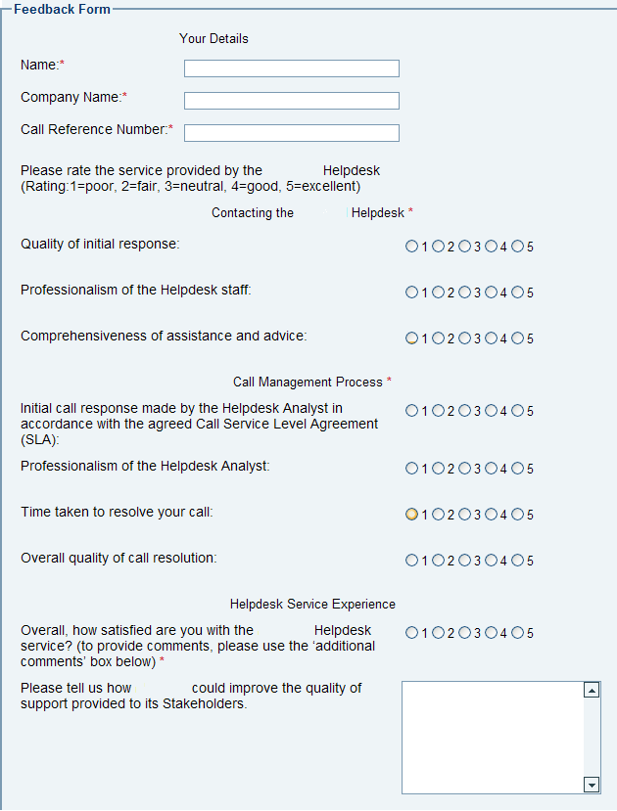
ICTSAS305 Provide Advice to Clients
Client feedback form

Slide 25
ICTSAS305 Provide Advice to Clients
Client feedback
Important things to remember when creating feedback forms:
Feedback received is only as good as the questions or information asked of the client
What method is best to use for this task?
What information does it need to gather?
How will it be distributed?
What instructions will be needed?
How will the data be collected and analysed?
How will the results be published?

Slide 26
ICTSAS305 Provide Advice to Clients
Client feedback
Analysing Feedback
Failure to properly analyse the results of the survey will not only render the whole processes useless, but also potentially cause a loss of trust from your clients if they do not see any results of the action.
Follow these steps to help you with the analysis:
Set a benchmark
Conduct the survey
Record the findings
Feedback report
Notes:
Set a benchmark
Use previous surveys to compare to the current.
Feedback report
Should include:
Back ground information on the company and previous survey results
Aim of the survey
Who was surveyed
Number of people
Percent of clients
Demographic area
Methods taken
Benchmarks
Results
Suggestions for improvement and how it will be done
Future plans
Next survey

Slide 27
ICTSAS305 Provide Advice to Clients
Client feedback
Implement change
Some areas that will affect change will be:
Costs of implementation.
Adherence to Legislations and company policies.
Likelihood of improvements being realised.
Risks.
Number of staff required to implement changes.
Note: Be careful not to change for change sake. The idea of this process is to improve the service and/or processes, not to change the world. Too much change could actually cause the customer service levels to deteriorate rather than improve.

